Slide 1
Welcome aboard

Slide 2
Content of session
01
02
03
04
05
Introduce yourself
why Game Development
Why Godot
Rules
Quick look on godot

Slide 3
Let’s Play a
Game

Slide 4
Tell us
Only
1 Rule
No
programming
Who you are
one skill / good trait you have
one thing you want to learn
The name of 3 people in the room

Slide 5
01
Why Game
Development

Slide 6
Why ?

Slide 7
01
02
03
Impact on You
Impact on the world
What you get out of it
What it means for others
Takeaway
Get to the point Ammar

Slide 8
Impact on YOU
What does making games mean for you
Making games is creative process that involves coding, design and more
Creative outlet
Complex Systems that will sharpen your brain
Game design is the UX peak

Slide 9
Impact on the World
WE owe our ideas a voice
Don’t Believe me ? let's talk Numbers
Industry sizes in 2024
(largest estimates) USD
Music : 30 Billion
Film : 120 Billion
Anime : 35 Billion
total : 165 Billion
Gaming industry (small estimate)
184 Billion
Games are one of the most impactful forms of media today both in positive and negative ways
It is our duty to leave a mark

Slide 10
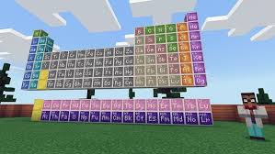


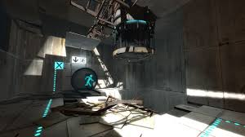
Games with positive impact

Slide 11

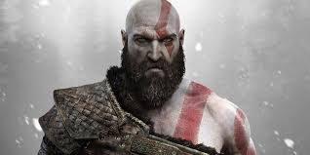
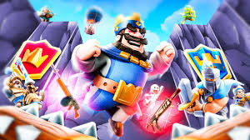

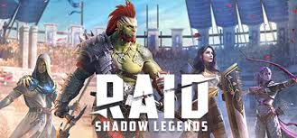
Games with negative impact

Slide 12
Hall of shame

Slide 13

Why do we love Godot
Here at open source community we love everything that is ….. well open source
and Godot is one of those things
it is a free , opensource , mit license , beginner friendly game engine

Slide 14


This is a car

Slide 15
What is
the main takeaway here
Don’t look for something important to do , look for importance of everything you do
Your reason is valid my opinions are just food for thought

Slide 16
Let's set some Rules
also who is mohsen?

Slide 17
Quick look inside Godot

Slide 18
Thanks!
Any Questions

